Slide 1


William Stallings Computer Organization and Architecture 8th Edition
Chapter 9
Cont. Computer Arithmetic
Book by : Computer, Architecture and Organizations, 8th Edition ,William Stalling
Original Slides by : Adrian J Pullin

Slide 2
Cont. Computer Arithmetic
Book by : Computer, Architecture and Organizations, 8th Edition ,William Stalling
Original Slides by : Adrian J Pullin
Adapted by: Ilyas Younus Essani

Slide 3
Lecture Outcomes
Understanding of:
Division
Division Unsigned Binary Integer
Booth’s Algorithm for Division
Floating Point
Floating Point Addition & Subtraction
Floating Point Multiplication & Division

Slide 4
Division
More complex than multiplication
Negative numbers are really bad!
Based on long division

Slide 5
Division of Unsigned Binary Integers
00001101
Quotient
Divisor
1011
10010011
Dividend
1011
001110
Partial
Remainders
1011
001111
1011
Remainder
100

Slide 6
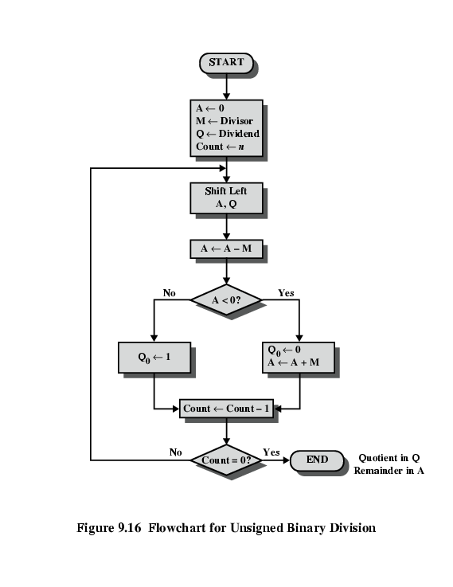
Flowchart for Unsigned Binary Division

Slide 7
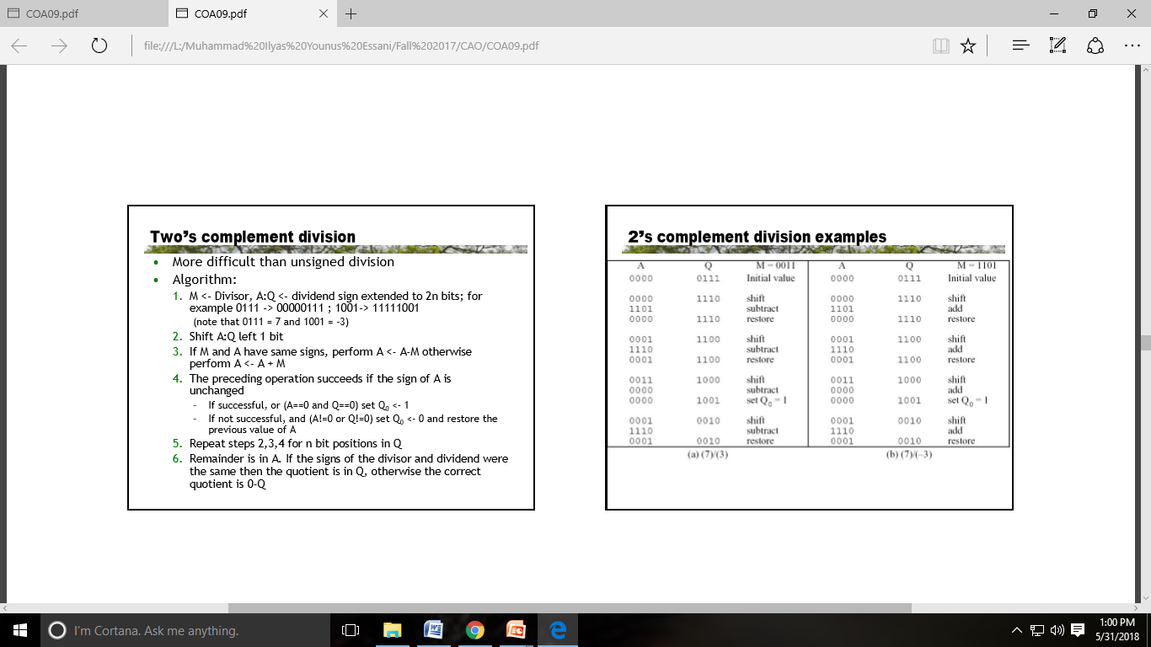

Slide 8


Slide 9
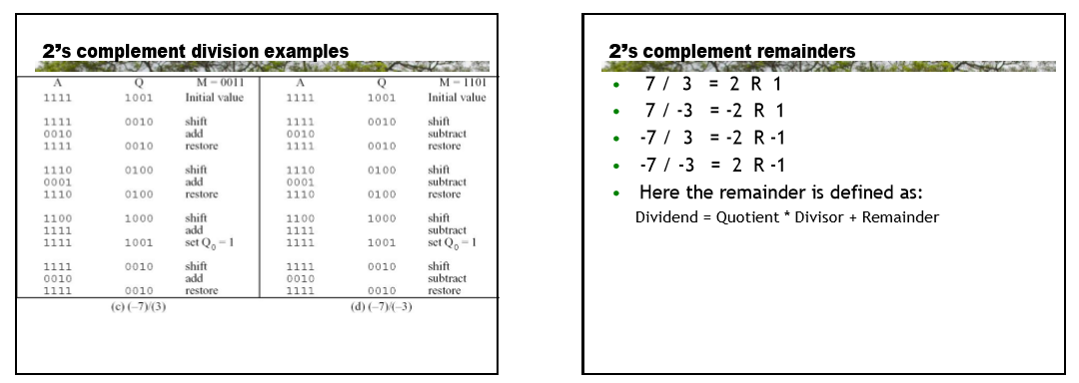

Slide 10
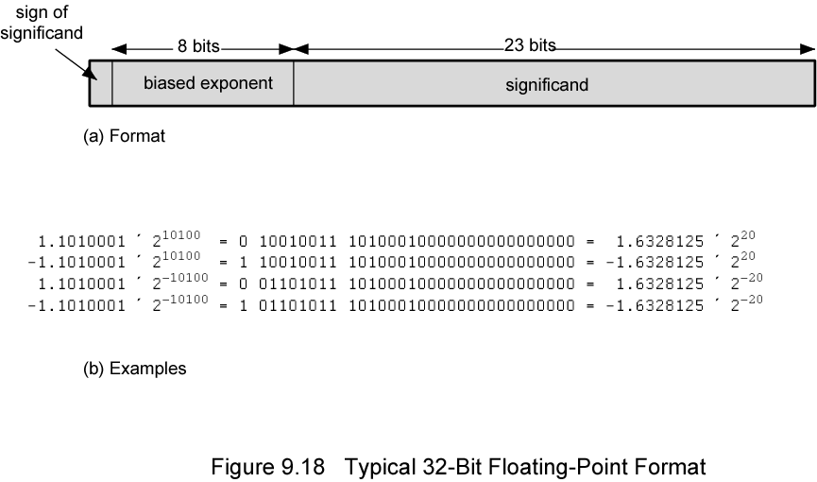
Floating Point
+/- .significand x 2^{exponent}
Misnomer
Point is actually fixed between sign bit and body of mantissa
Exponent indicates place value (point position)

Slide 11
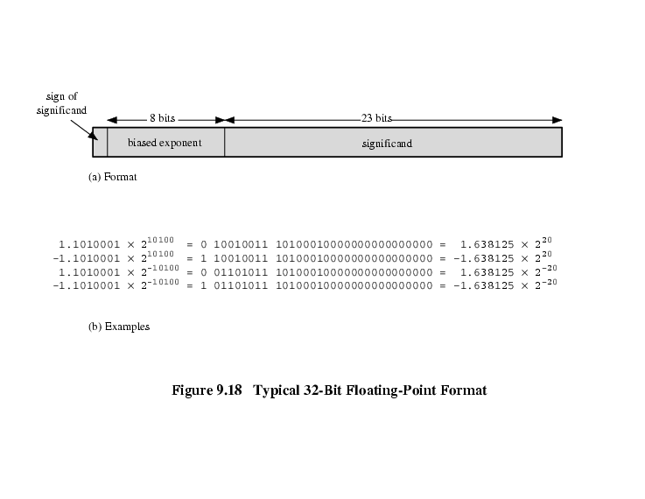
Floating Point Examples

Slide 12
Signs for Floating Point
Mantissa is stored in 2s compliment
Exponent is in excess or biased notation
e.g. Excess (bias) 128 means
8 bit exponent field
Pure value range 0-255
Subtract 128 to get correct value
Range -128 to +127

Slide 13
Normalization
FP numbers are usually normalized
i.e. exponent is adjusted so that leading bit (MSB) of mantissa is 1
Since it is always 1 there is no need to store it
(c.f. Scientific notation where numbers are normalized to give a single digit before the decimal point
e.g. 3.123 x 10³)

Slide 14
FP Ranges
For a 32 bit number
8 bit exponent
+/- 2²⁵⁶ ≈ 1.5 x 10⁷⁷
Accuracy
The effect of changing lsb of mantissa
23 bit mantissa 2⁻²³ ≈ 1.2 x 10⁻⁷
About 6 decimal places

Slide 15
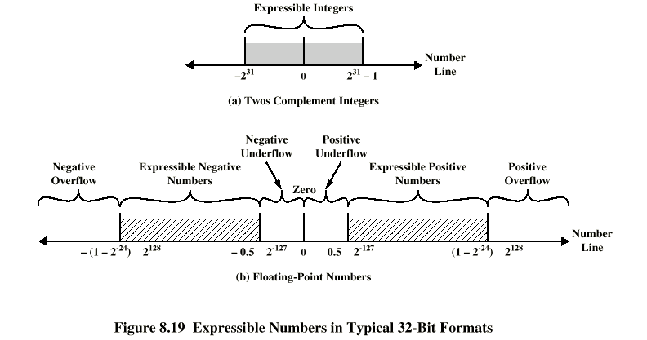
Expressible Numbers

Slide 16
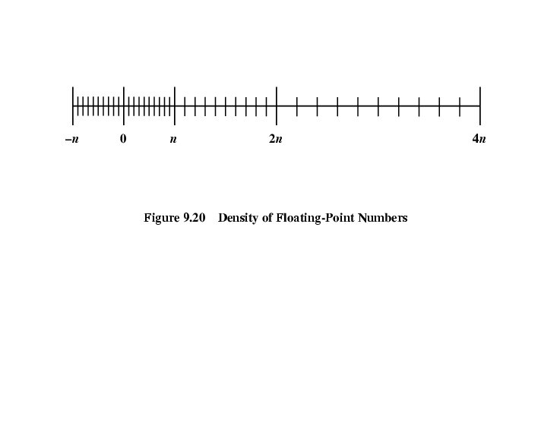
Density of Floating Point Numbers

Slide 17
IEEE 754
Standard for floating point storage
32 and 64 bit standards
8 and 11 bit exponent respectively
Extended formats (both mantissa and exponent) for intermediate results

Slide 18
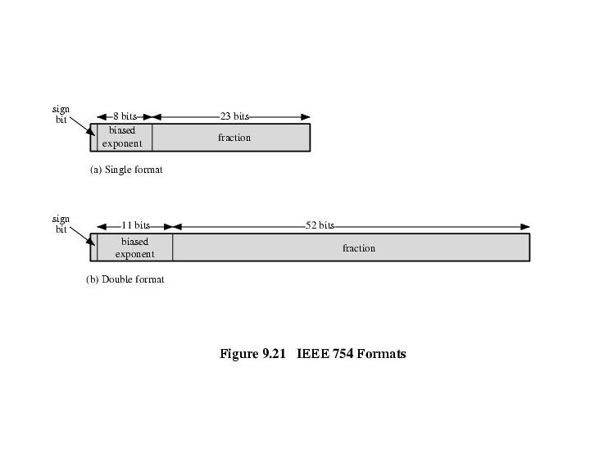
IEEE 754 Formats

Slide 19
FP Arithmetic +/-
Check for zeros
Align significands (adjusting exponents)
Add or subtract significands
Normalize result

Slide 20
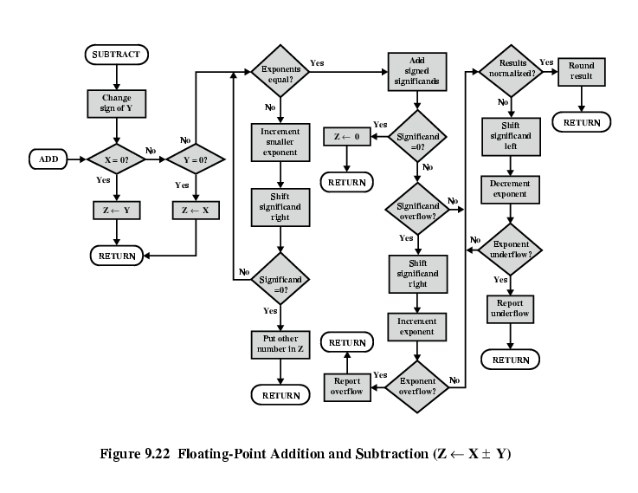
FP Addition & Subtraction Flowchart

Slide 21
FP Arithmetic x/÷
Check for zero
Add/subtract exponents
Multiply/divide significands (watch sign)
Normalize
Round
All intermediate results should be in double length storage

Slide 22
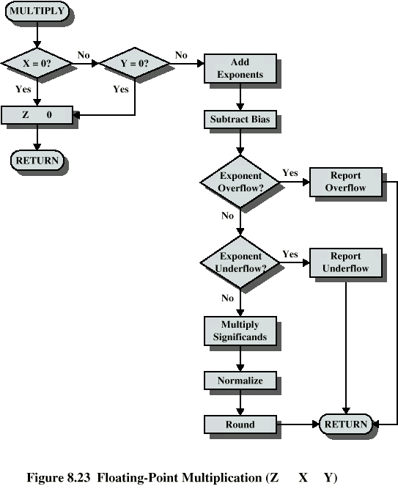
Floating Point Multiplication

Slide 23
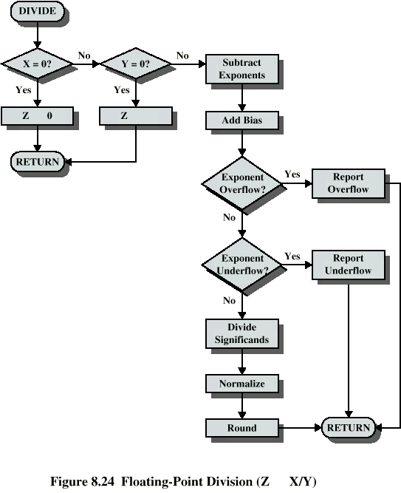
Floating Point Division

Slide 24
Review Questions
What are the differences among positive overflow, exponent overflow and significant overflow?
What are the basic elements of floating-point addition and subtraction?
Give a reason for the use of guard bits.
List four alternative methods of rounding the result of a floating-point
operation.

Slide 25
Thank you

